Slide 1

Exercise 2 Linear regression & Gradient descent

Slide 2
General Information
The programming assignment is due May 8, i.e. you have two weeks to work on it
We added a tutorial notebook on building Neural Networks using PyTorch. This is just additional information, no extra submission necessary.

Slide 3
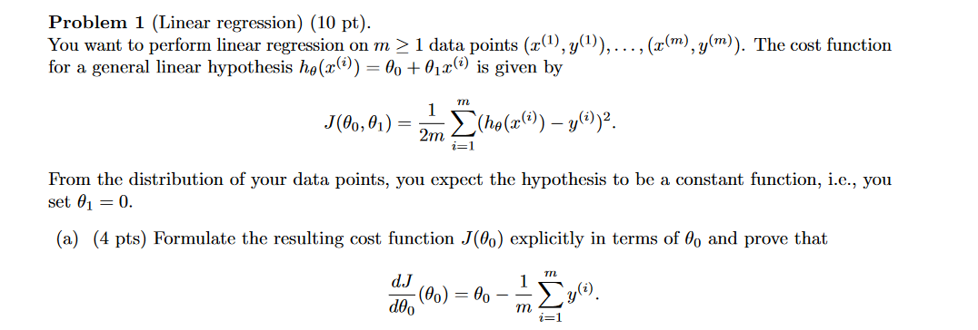
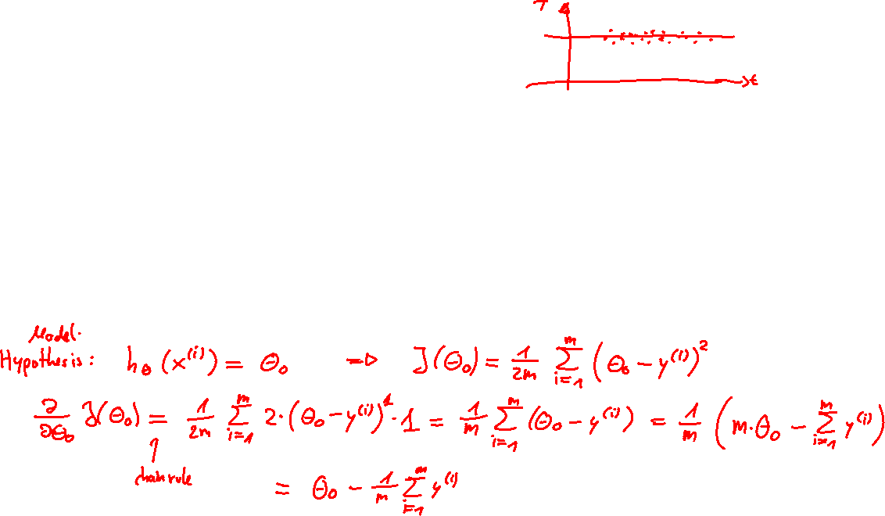
Problem 1

Slide 4
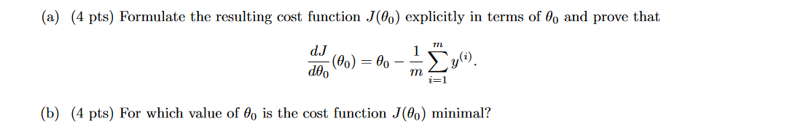
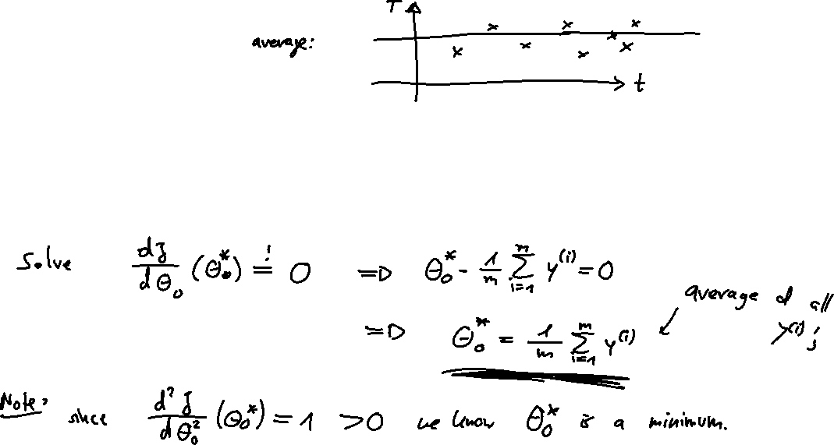
Problem 1

Slide 5
Problem 1

Slide 6
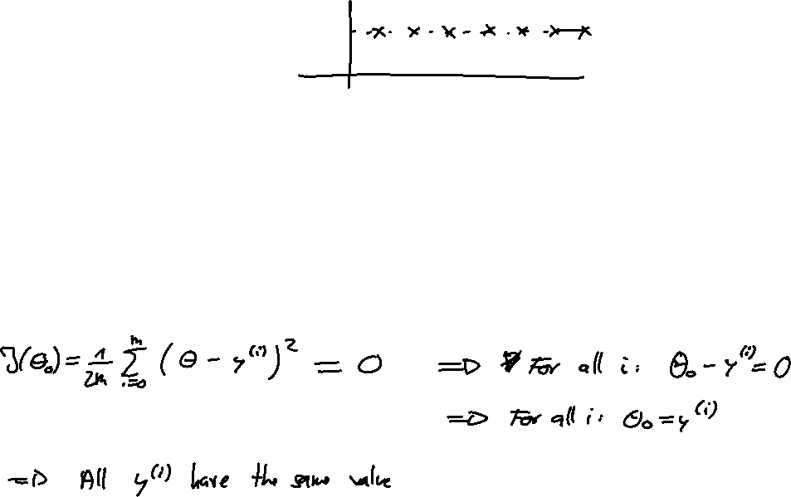
Problem 1

Slide 7
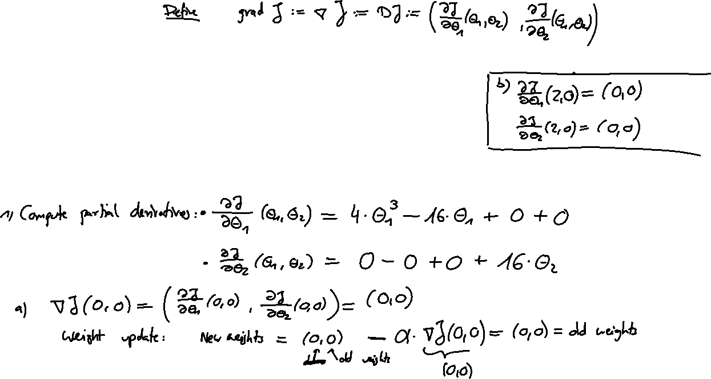
Problem 2

Slide 8
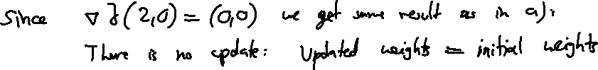
Problem 2

Slide 9
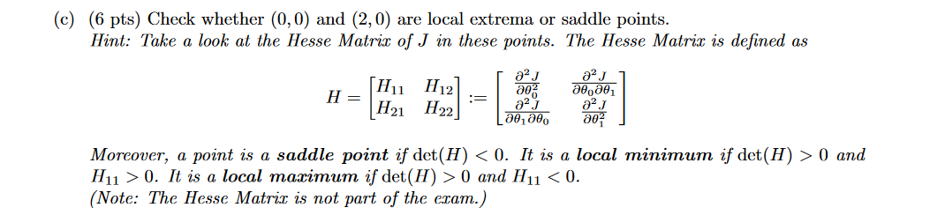
Problem 2

Slide 10
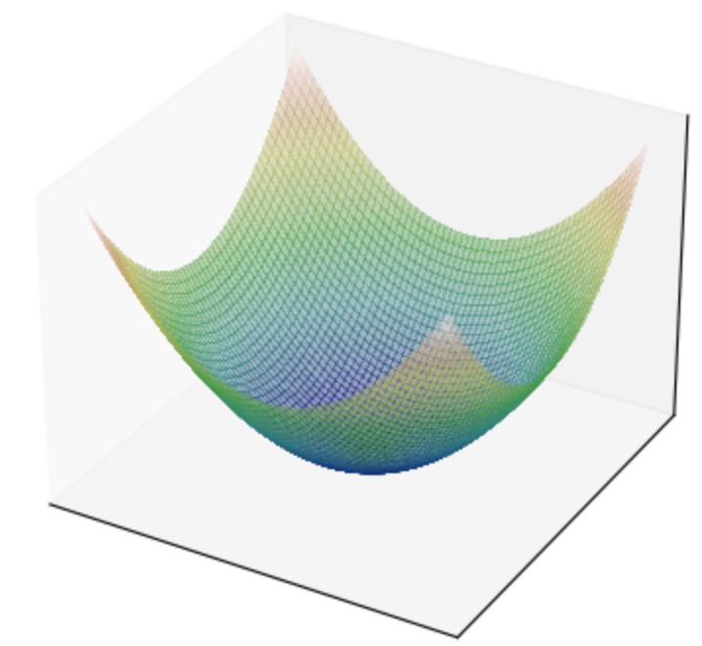
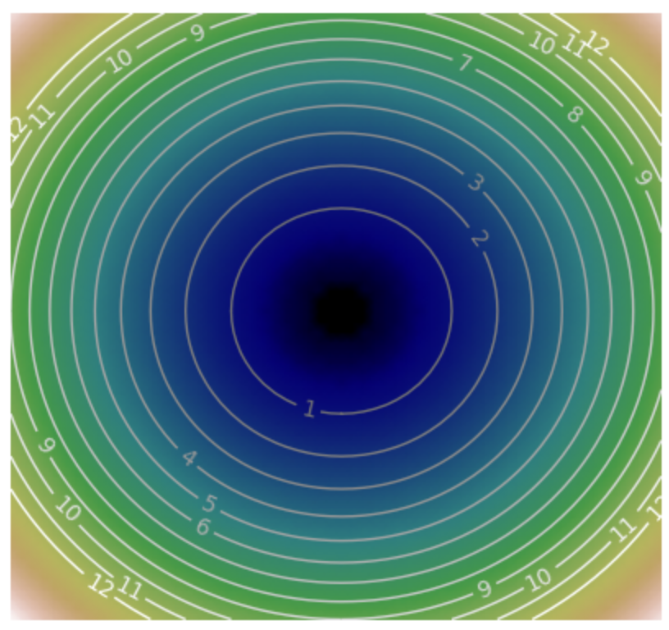
Local minima

Slide 11
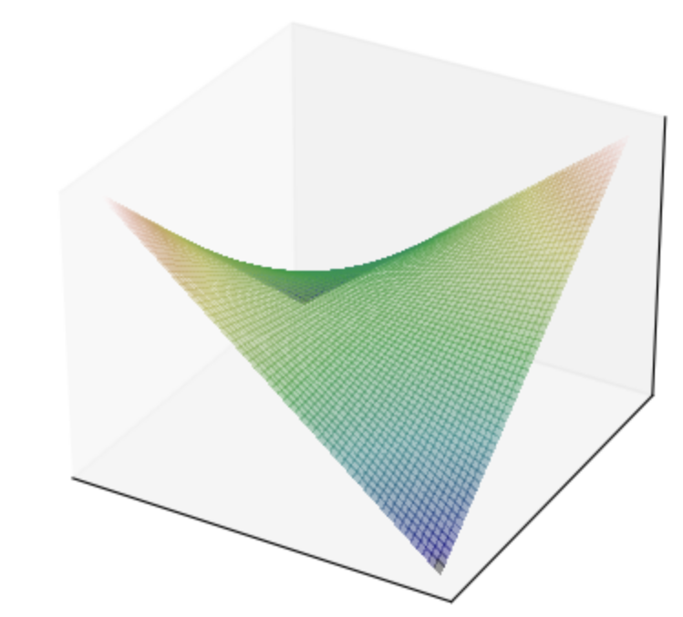
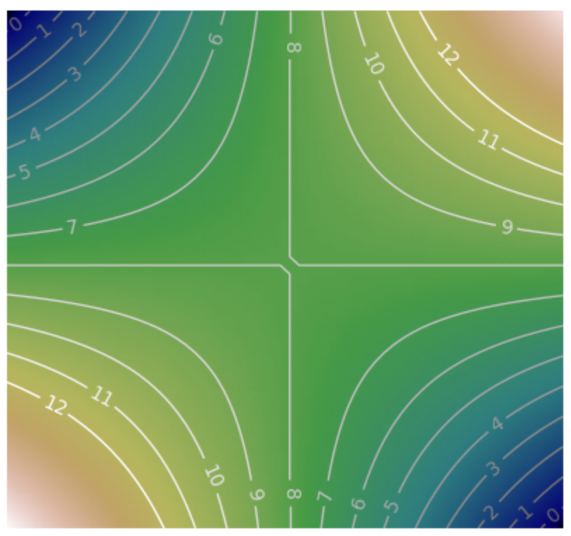
Saddle points

Slide 12
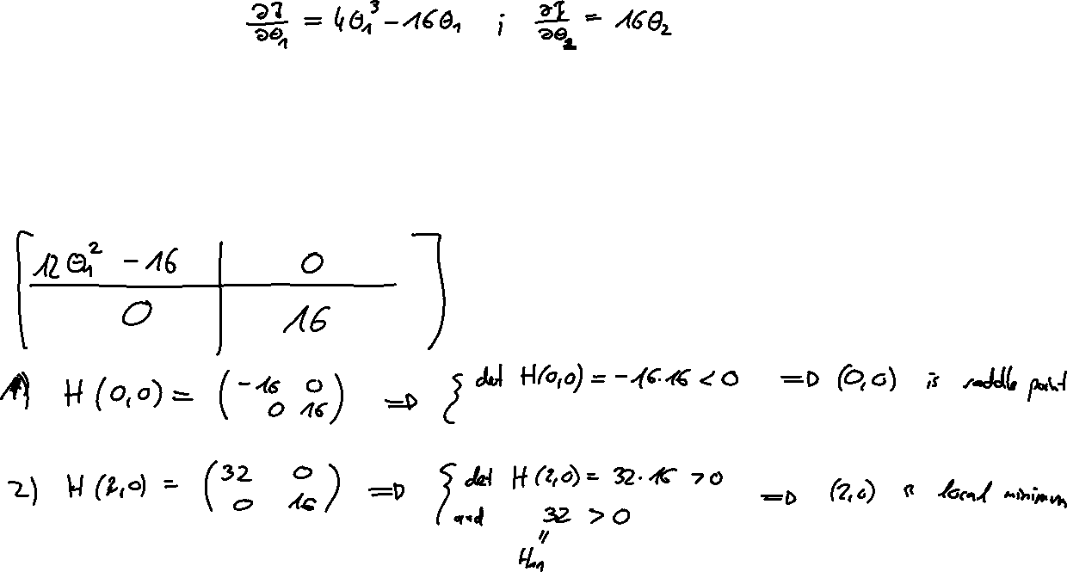
Problem 2

Slide 13
Problem 2

Slide 14
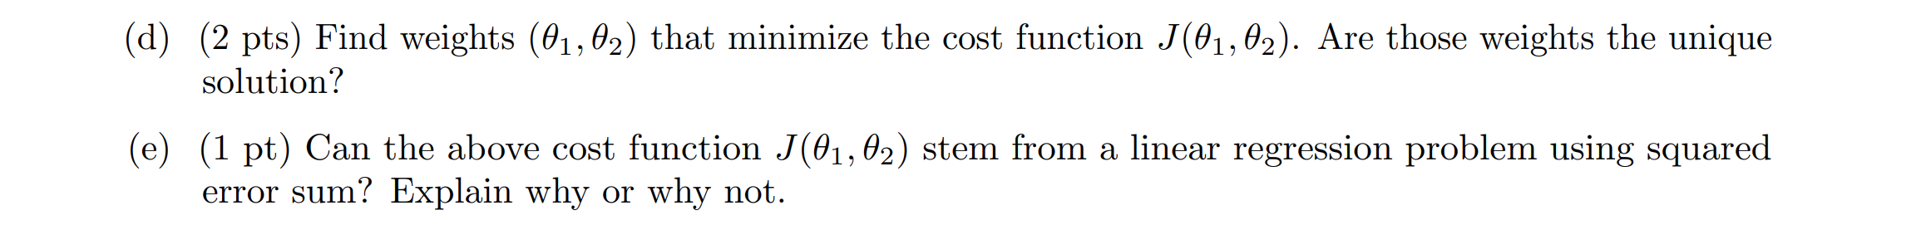
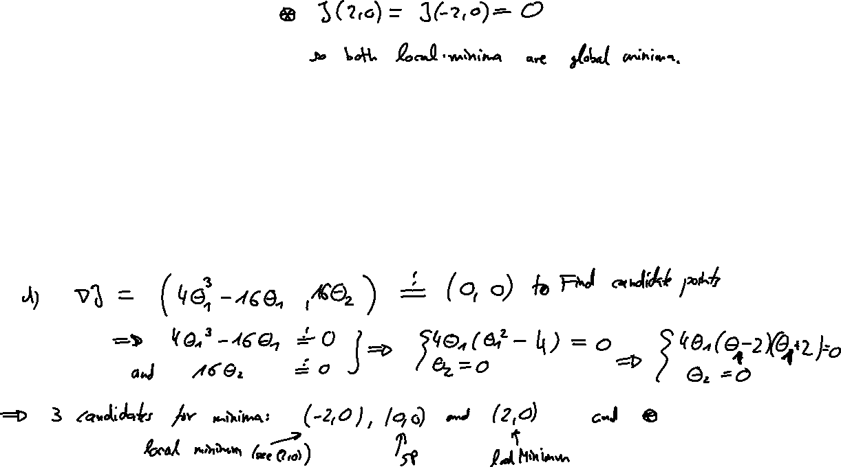
Problem 2

Slide 15
Problem 2

Slide 16
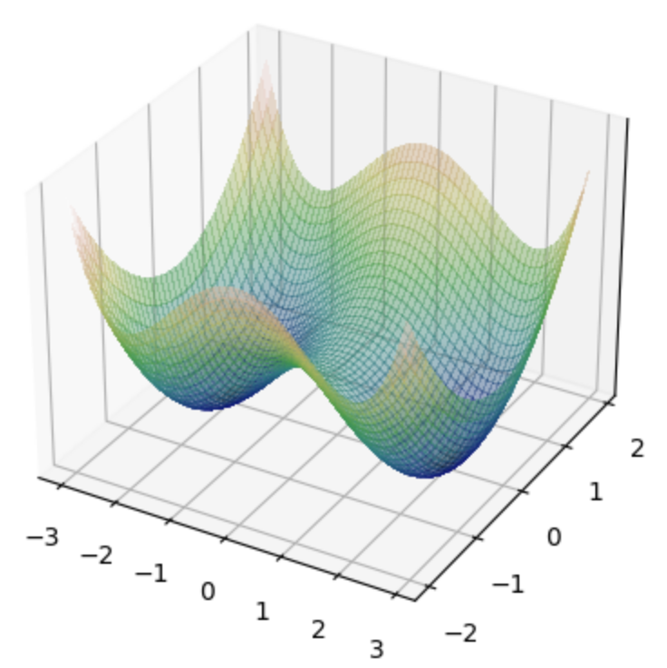
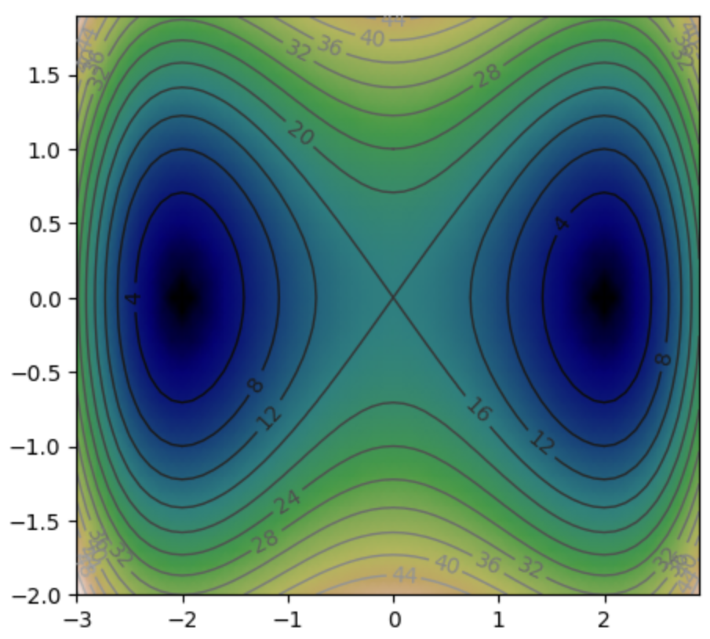
Problem 2

Slide 17
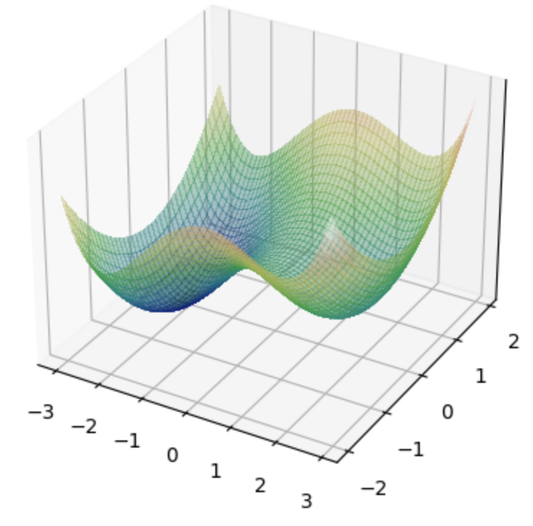
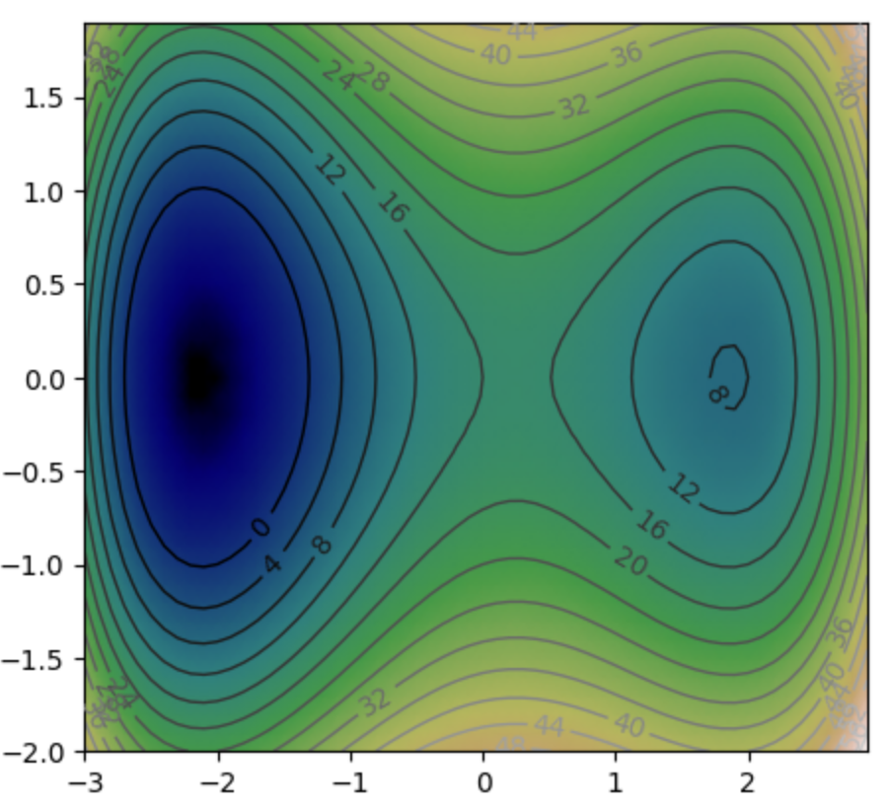
Another example

Slide 18
Logistic loss - Motivation

Slide 19

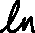
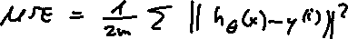
Logistic loss - Motivation
Logistic loss function:
Model hypothesis for logistic regression:

Slide 20

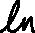
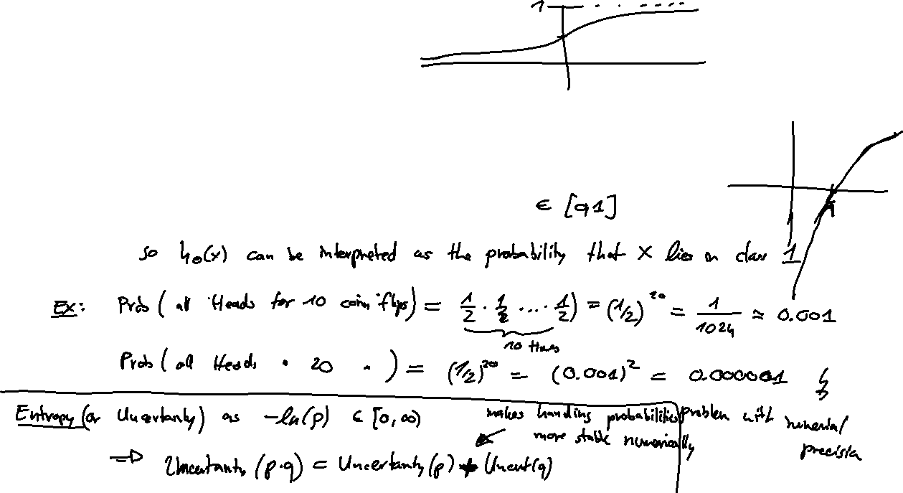
Logistic loss - Motivation
Logistic loss function:
Model hypothesis for logistic regression:

Slide 21
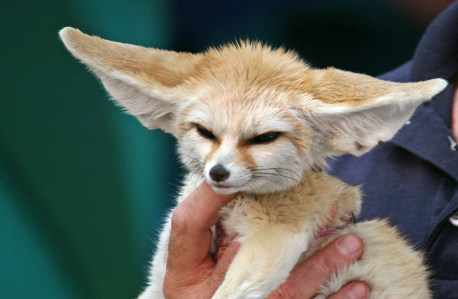

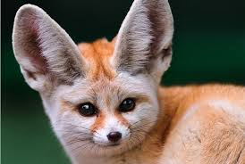
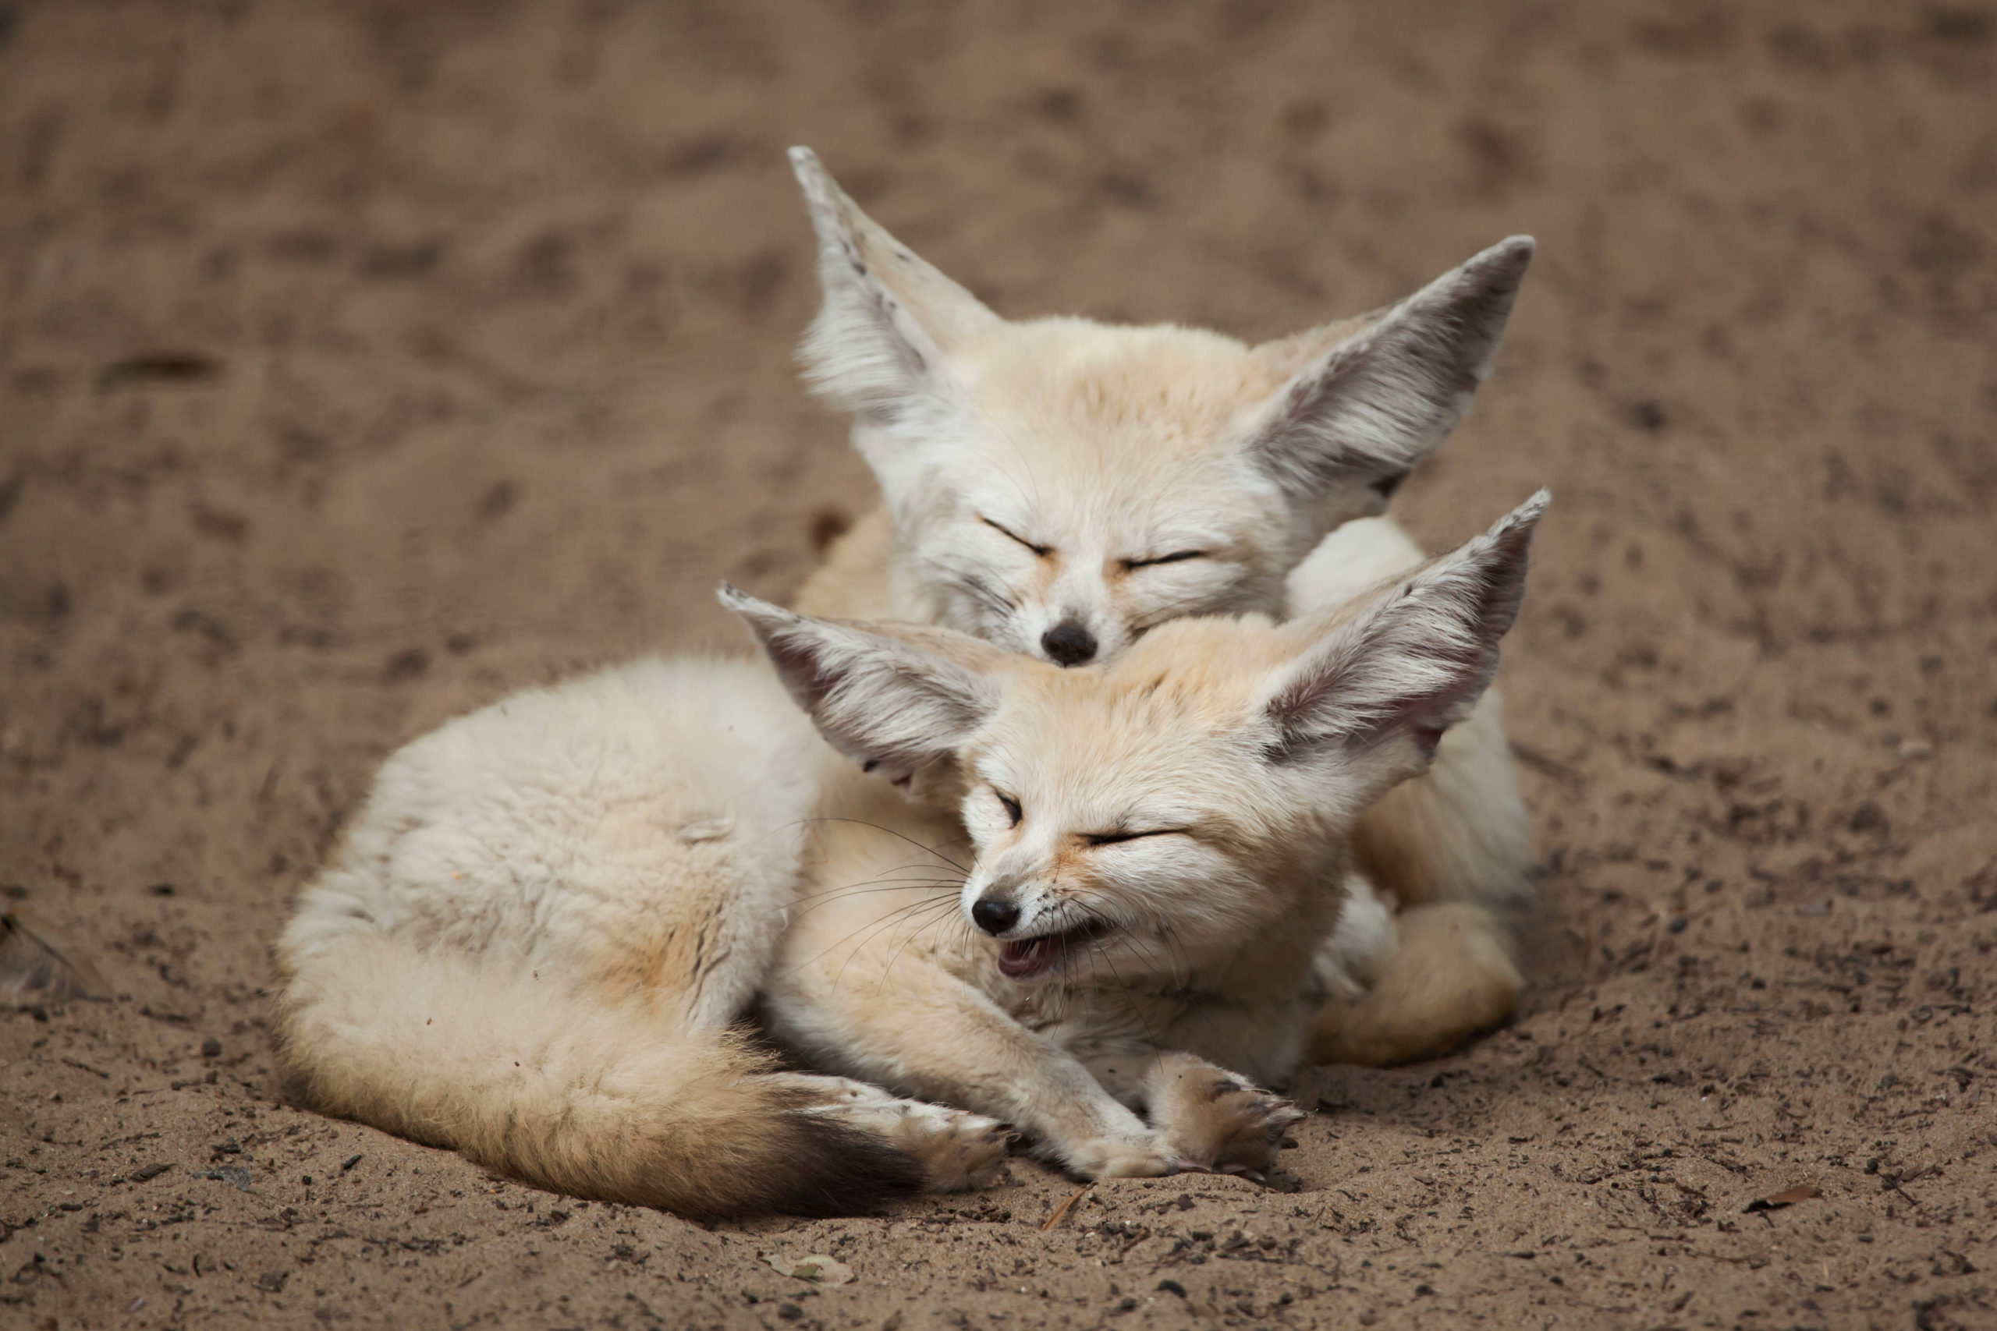
QUIZTIME

Slide 22
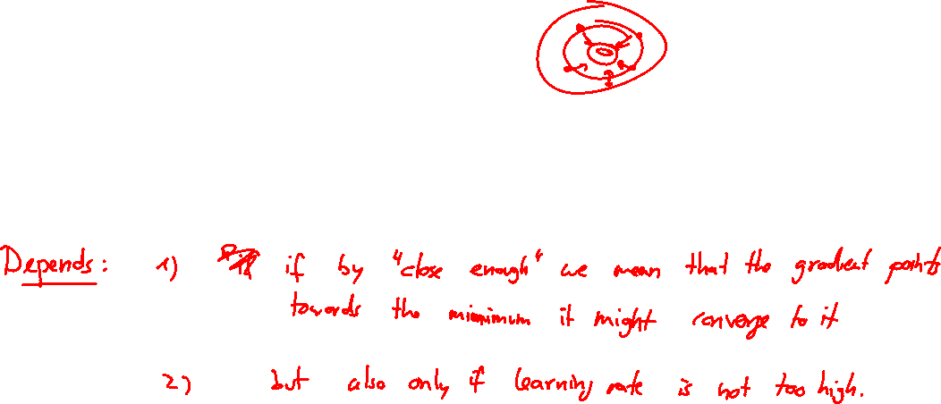
Quiztime
True or False?
If the initial weights are close to a local minimum, the result of Gradient Descent will be this local minimum.

Slide 23
Quiztime
True or False?
If the initial weights are close to a local minimum, the result of Gradient Descent will be this local minimum.

Slide 24

Quiztime
True or False?
If the initial weights are close to a saddle point, the result of Gradient Descent will be this saddle point.

Slide 25
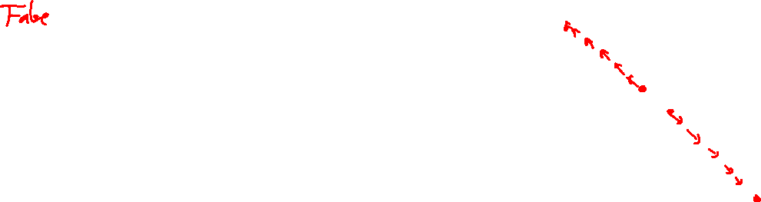
Quiztime
True or False?
If the initial weights are close to a saddle point, the result of Gradient Descent will be this saddle point.

Slide 26
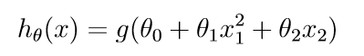
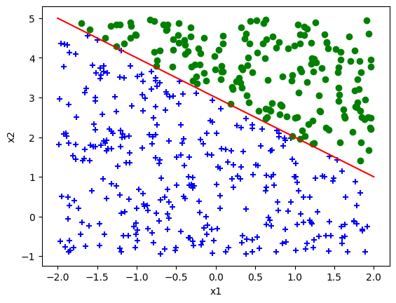
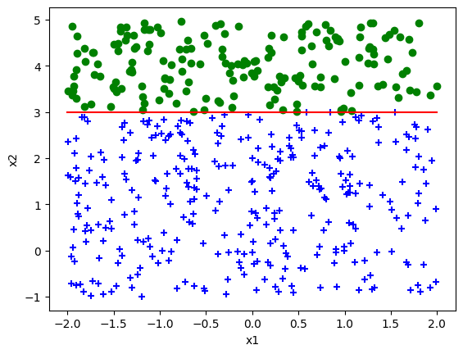
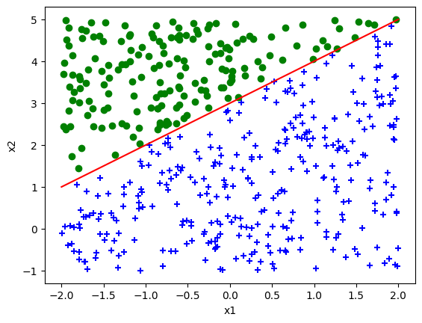
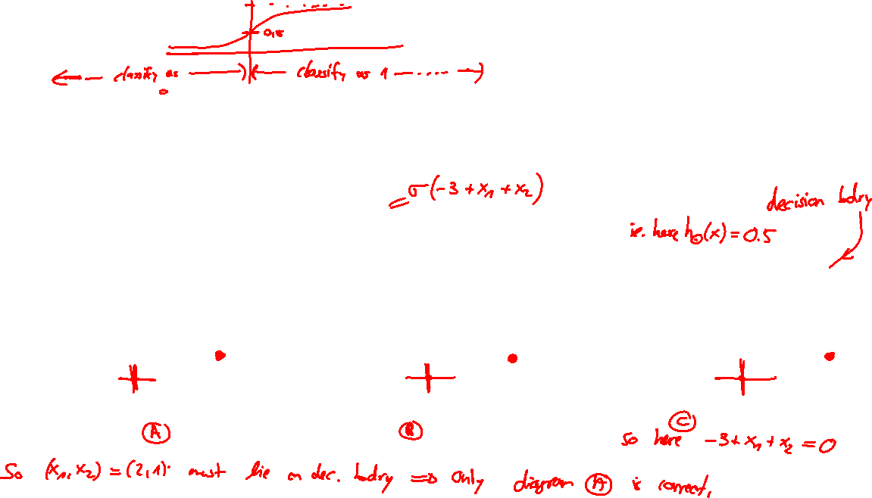
Quiztime
Question:
Which of these images shows a logistic regression prediction with weights θ = (-3,1,1)?

Slide 27
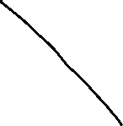
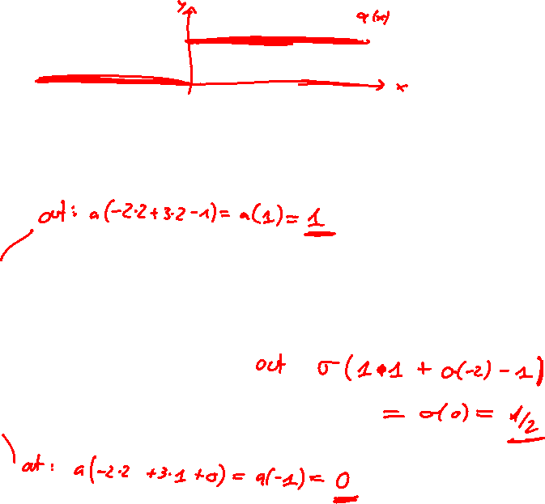
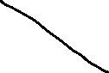

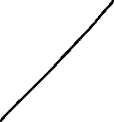



Neural Networks
Question
What is the output of the following simple Neural Network?

Slide 28
Regularization
True or False?
In order to avoid overfitting, you should increase the regularization parameter.

Slide 29
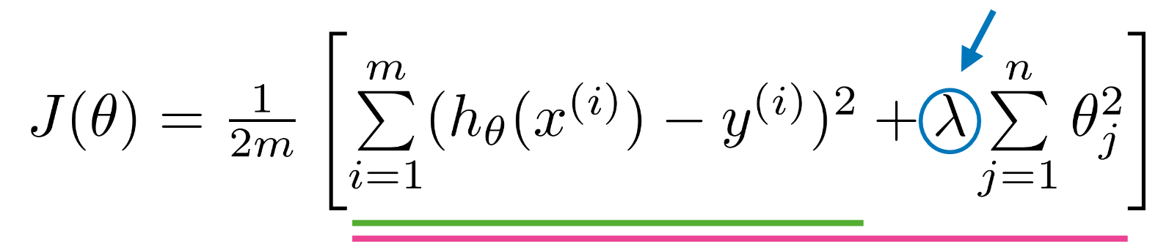
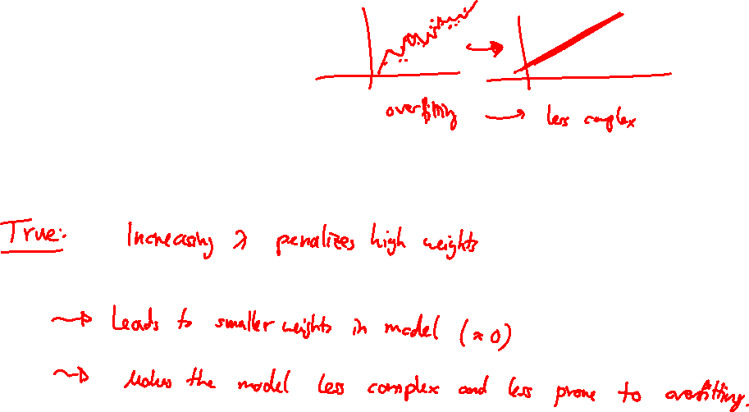
Regularization
True or False?
In order to avoid overfitting, you should increase the regularization parameter.

Slide 30
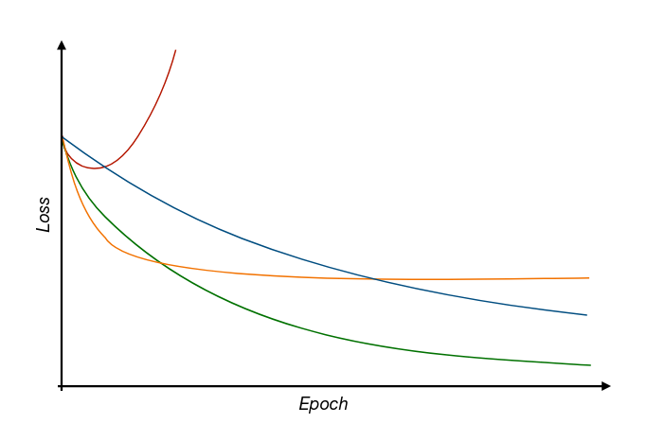
Learning rate
Question
What can be said about the learning rate during these different runs of Gradient Descent based on how the loss function behaves with increasing iterations?
Iterations

Slide 31
Thank you for your attention

